Slide 1
Outage Alerts
Team A:
Nick Piluso
Gregorson Mahon
Taylor Peck

Slide 2
What is outage Alerts?
Outage Alerts is a web service to notify you of a power outage via email or cell phone
You can add recipients and properties, and when an outage at a property occurs the selected recipient will receive a notification alerting them of the outage

Slide 3
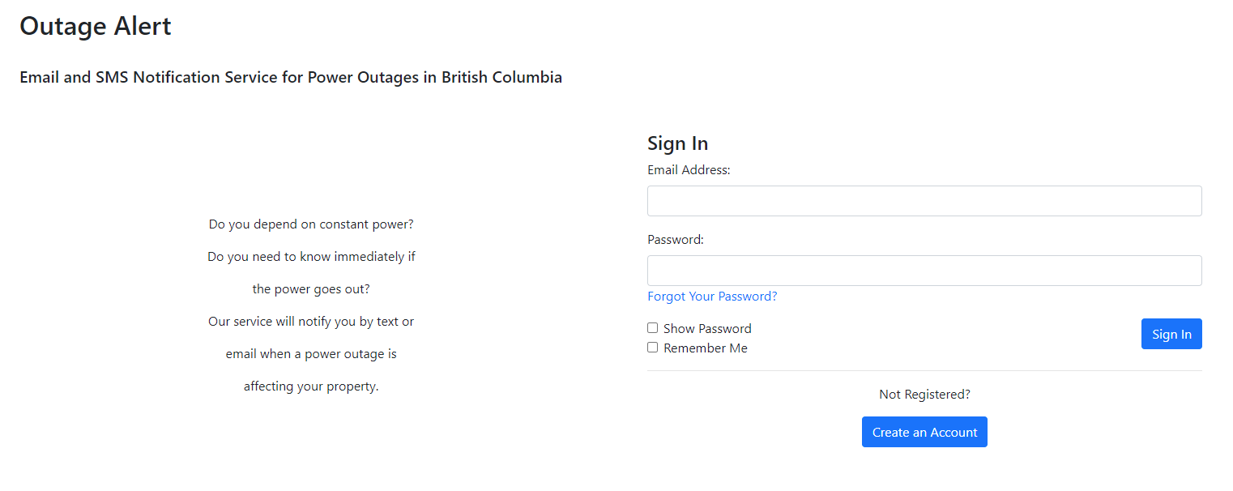
Login PAge

Slide 4
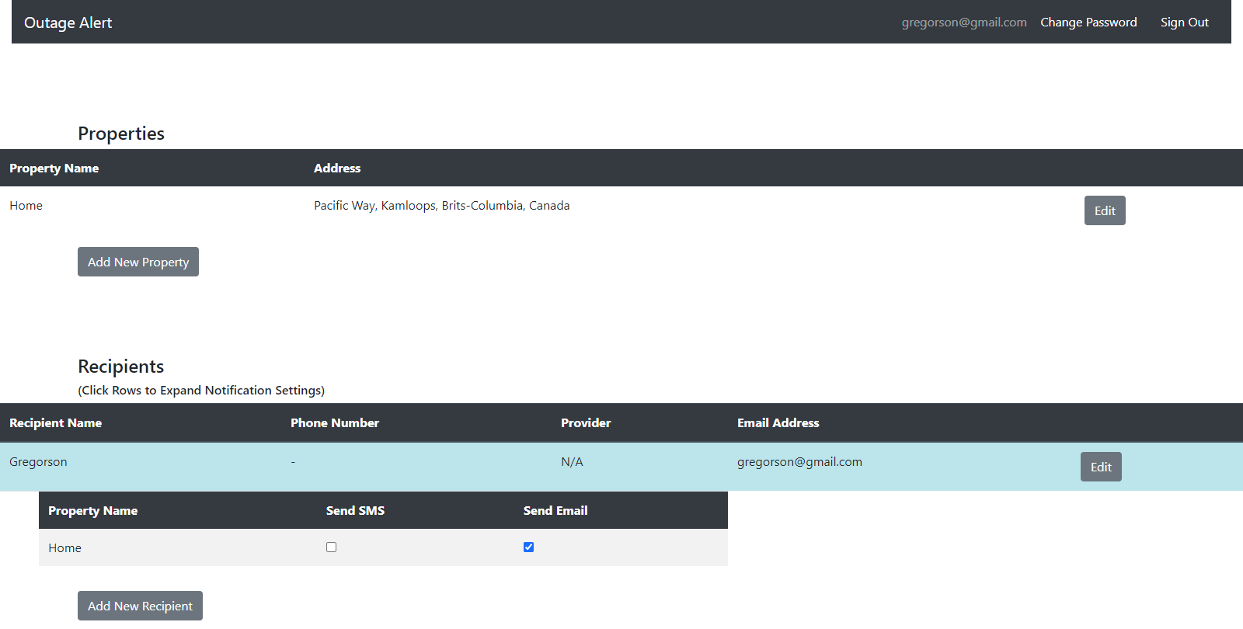
Site main Page

Slide 5
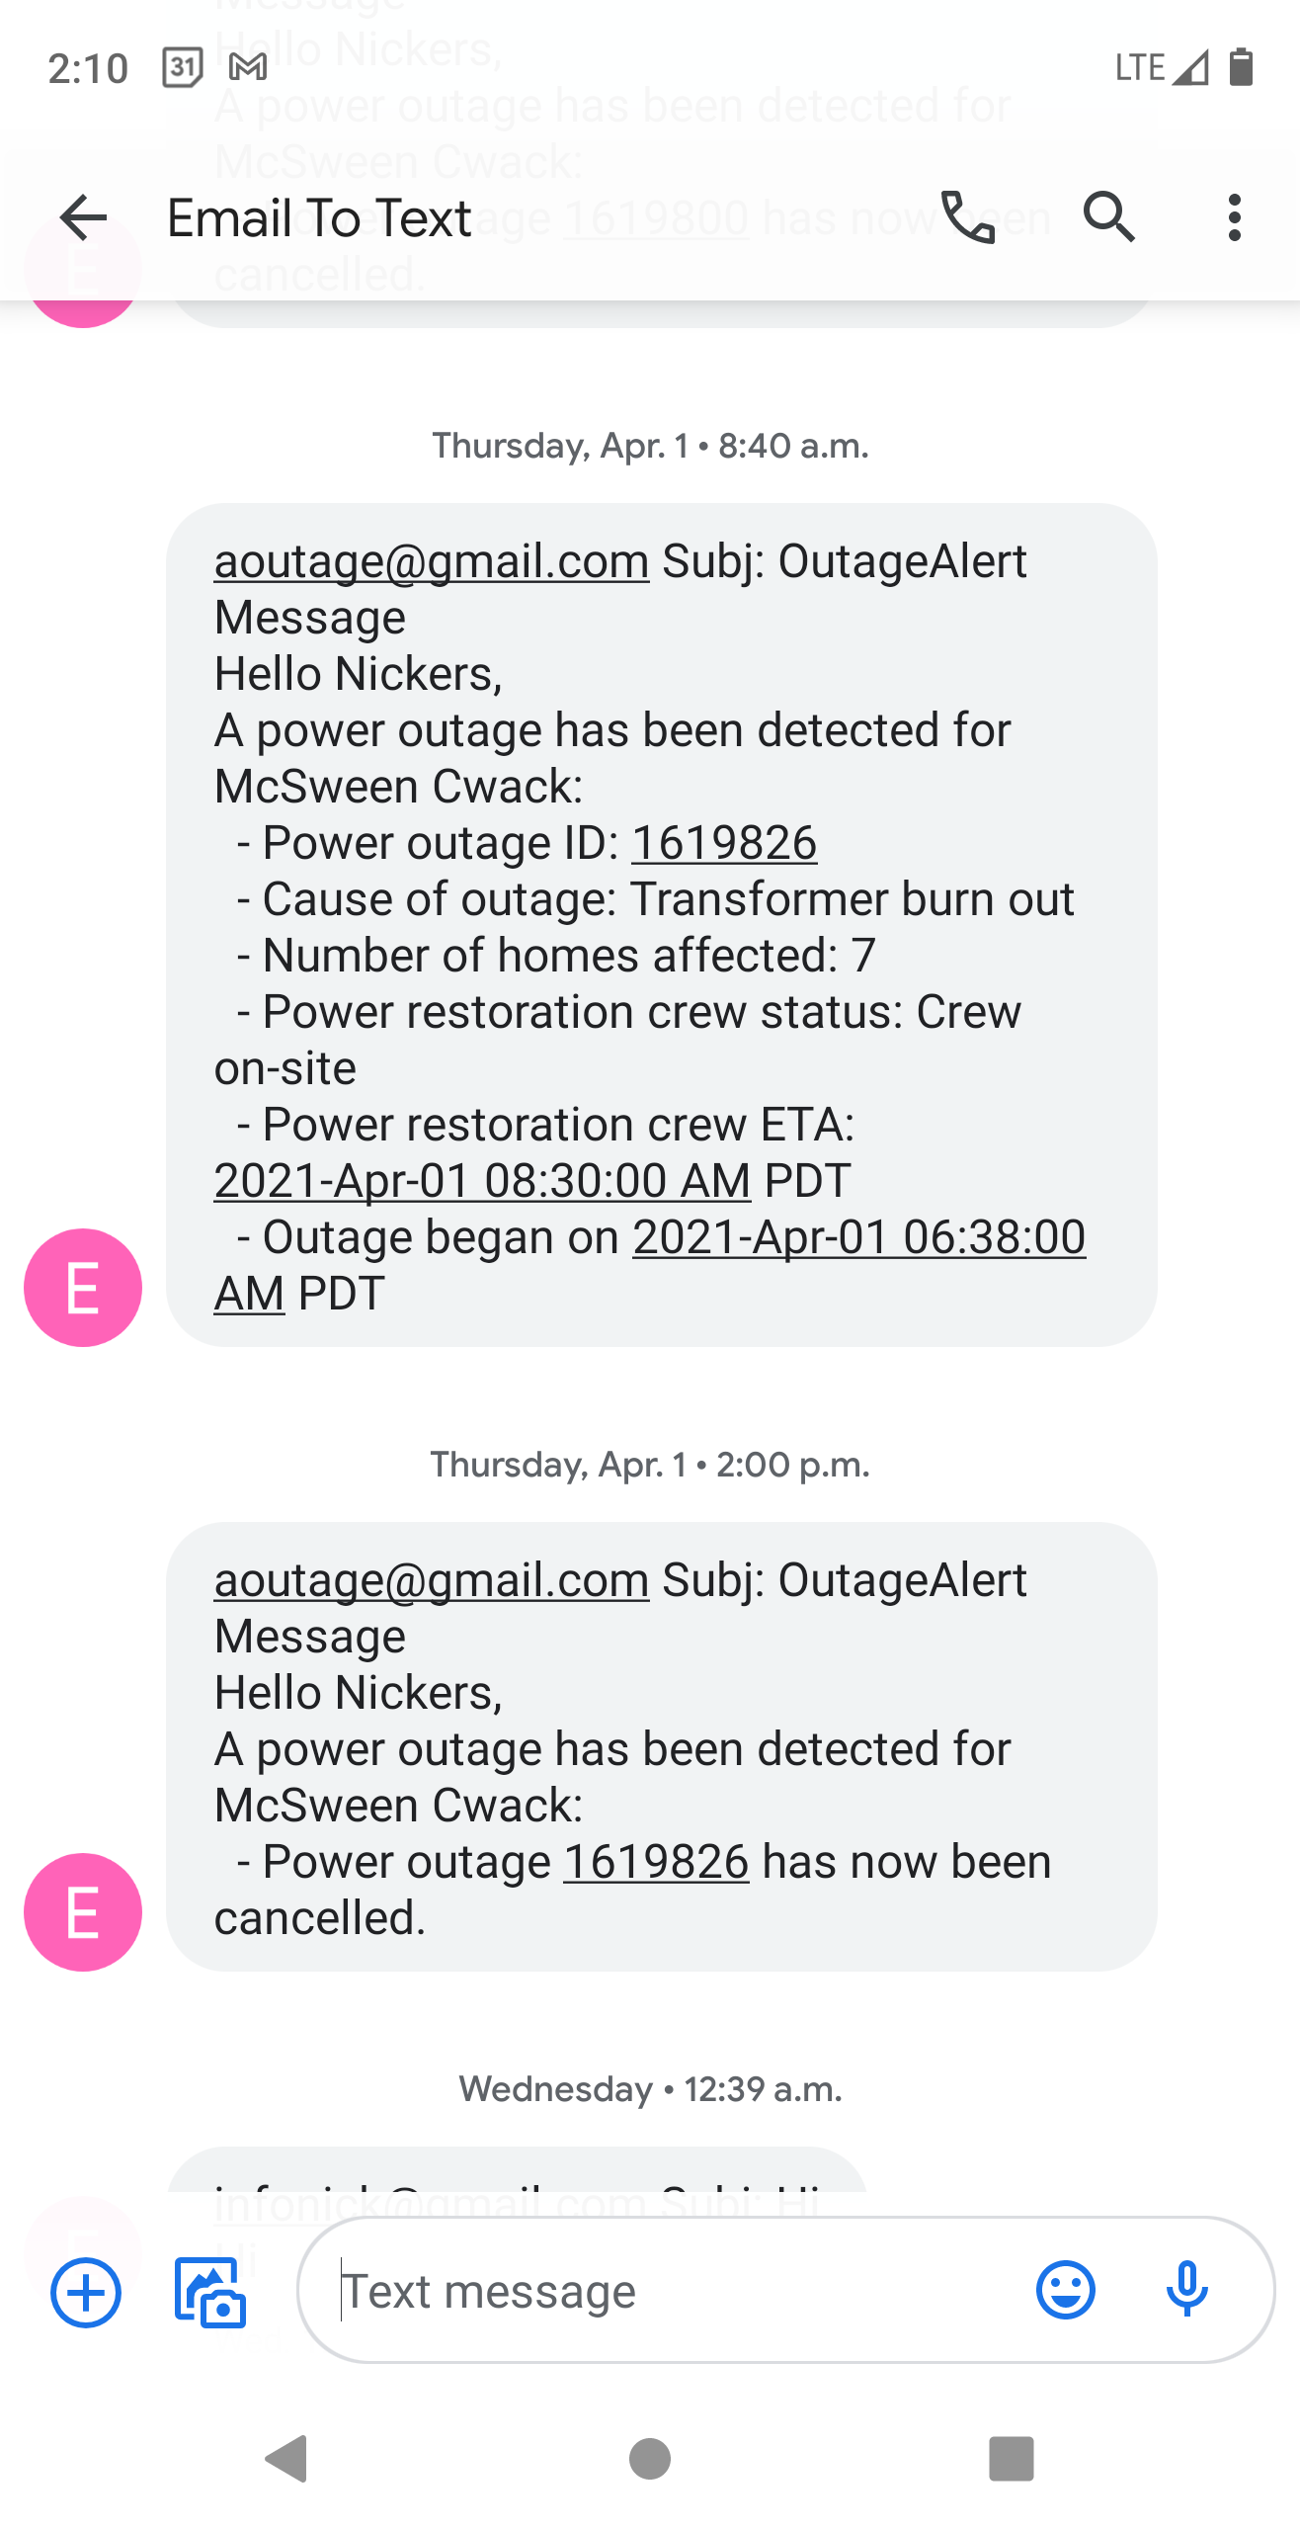
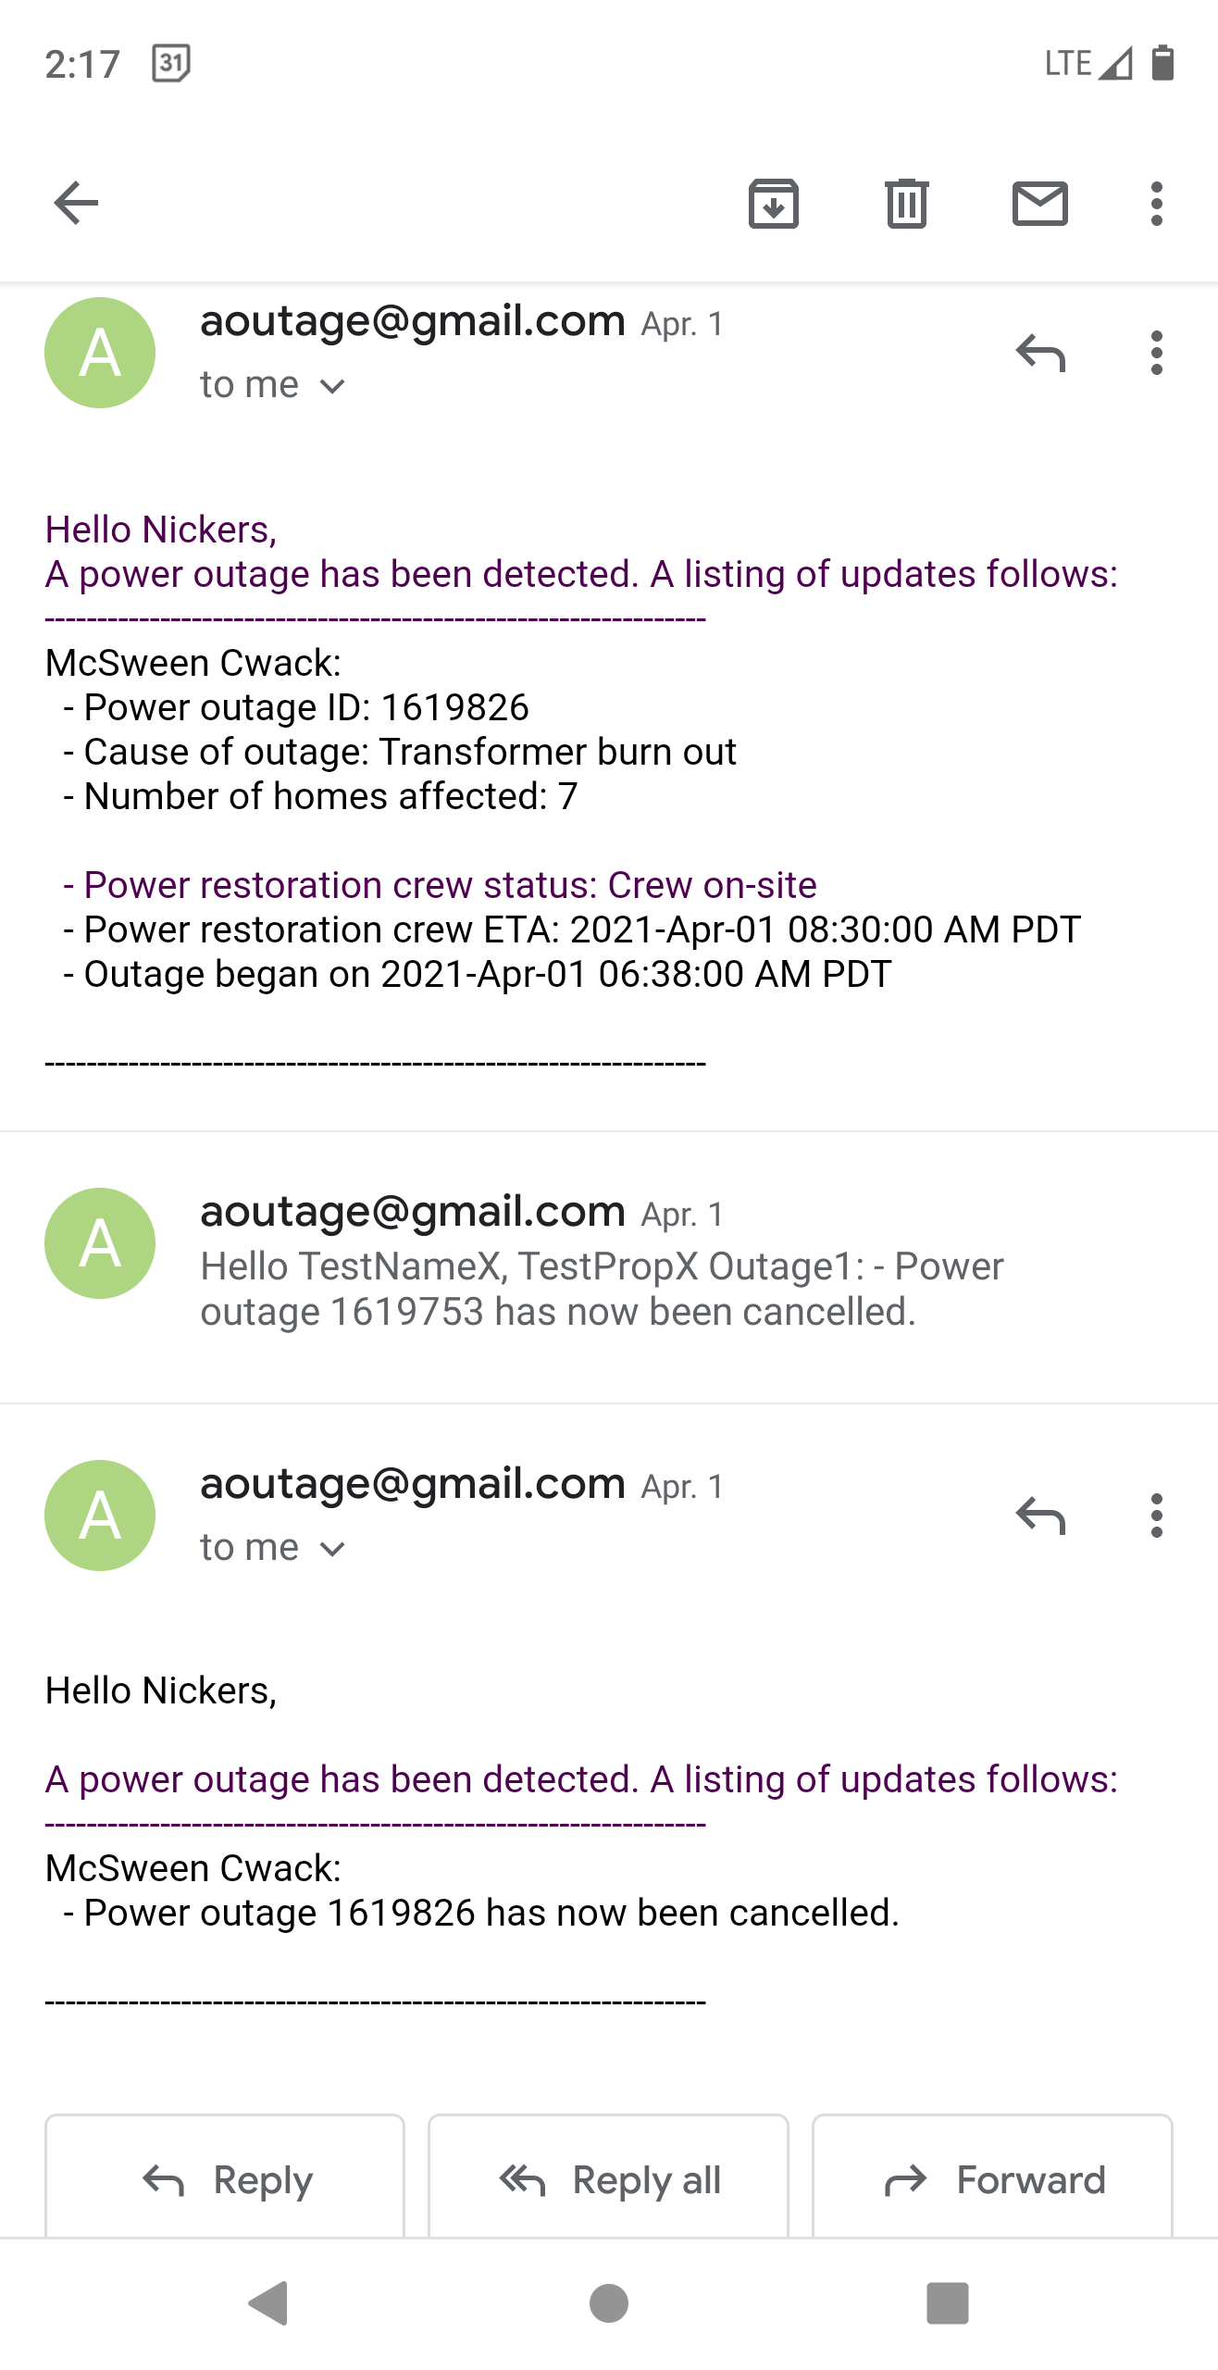
Alerts

Slide 6
User testing

Slide 7
TAsks
Create a user account
Add a recipient (use email:aoutage@gmail.com, phone number: xxx-xxx-xxxx, carrier: x)
Add a property (4440 W Saanich Rd, Victoria BC) and call it “my workplace”.
Ensure this recipient is set to receive notifications by either cell phone or email
Add yourself as a recipient
Add your own property
Ensure you are set to receive notifications by either cell phone or email
Change your password
Sign out
Try resetting your password
Use the new/recovered password to log in

Slide 8
Questions
What parts of the site were easy to understand and why?
How did you know if you had successfully created a property/recipient?
Was any part of the UI distracting from the sites main purpose?
Was there any function or feature on the site you expected to find that was not present?
Were you satisfied with the sites features?
Did you know you can receive both email and cellphone notifications for the same property?
Did you know you could send the same recipient notifications for multiple properties?
Did you know you could add multiple recipients?

Slide 9
results
Notification's tab was hard to find for many users
Confusion as to what to start with upon first login
Not always clear that buttons were buttons
User tried to click on properties header expecting something to happen
Verification toasts disappeared too quickly
Users tried to create an account on the sign in form
Users had issue entering phone numbers because “-”’s were not allowed
After password reset users didn’t automatically go back to log in page
Users were confused as to whether or not they had completed their user goal
User added a property without using the autocomplete feature which didn’t add the property correctly
Users were unclear that they could add multiple recipients/properties
When resetting password, there is no option to show text unlike the login page so users cant confirm what they entered
After users entered a new recipient, they didn’t follow up by setting up notifications for them

Slide 10
Improve Notification setting options
Add an arrow and change background color on mouseover to better indicate that the row expands
Add a separate section for notification settings
Add notification settings to the form whenever you add a property or recipient
Have notification tab pre-expanded
Test out the above options to see what works best

Slide 11
Additional features to add
Adding a first-time setup wizard would be helpful for new users
Finish developing delete functionality
Allow user to change login email
Give users an option to see symbols typed when resetting password
When adding a new property, user should be forced to select an address from the auto-complete form
Let users sign by in pressing enter, rather then clicking the sign in button
No option to delete user account should the service no longer be desired
Include link to the website in password reset email
Add a one click disable feature for any recipient so that there is no need to disable each property individually
Add test notifications so that users feel confident the alerts will function correctly
Let users use “-”’s when entering phone numbers

Slide 12
Presentation Improvements
Change layout of the login page so that password recovery and create account section are in the same view
Change the language of the ‘forgot password’ reset button to make it 100% clear
Change buttons to make them more obviously buttons
Give cancel buttons a red outline and white fill for red/green color blindness contrast
Add support for screen readers and other accessibility tools
User was confused between ‘forgot password’ and ‘show password’ when retrieving lost password
Create account button was visible but users not find it obvious they needed to click it before entering information

Slide 13
Informational improvements
Change text on landing page to better indicate that a user will receive an email or text to their phone in the event of an outage
Include a section for additional useful information, such as setting up custom notification sounds when receiving an alert
Show examples of email and text alerts so users know what to expect
Prompt users to specially enter a cell phone number so they don’t enter their home phone number out of habit
Show some form of visual confirmation once the user goal has been achieved and allow confirmation toasts to linger longer

Slide 14
Any questions?

